Slide 1
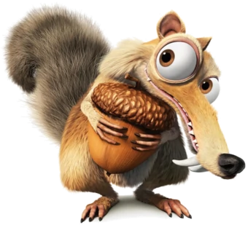
Check school email for Google Classroom access for each of your classes.

Slide 2
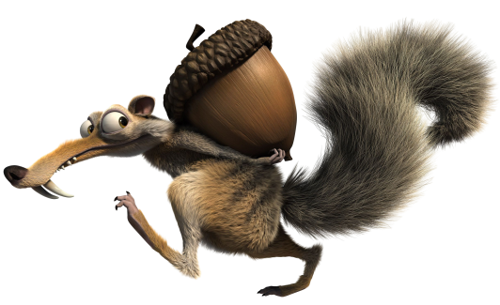
BE ON TIME
Wake up early.
Log on a few minutes
before class.

Slide 3
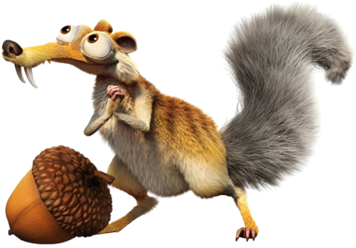
BE IN A QUIET PLACE
Find a quiet place.
Check your surroundings.

Slide 4
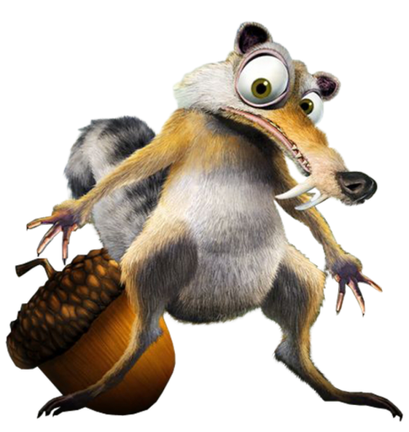
DURING PRESENTATION
Wear appropriate clothing.
Sit up straight.
Be in camera view.

Slide 5
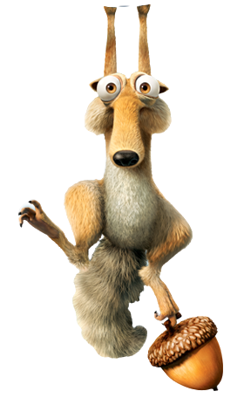
MUTE YOURSELF
Mute yourself when your teacher or another student is talking.

Slide 6
PARTICIPATE
Be focused.
Be attentive.
Be an active
participant.

Slide 7
CHAT RESPONSIBLY
Raise your hand to speak.
Type your question in the chat box.

Slide 8
COMMUNICATE WELL
Speak clearly.
Look up when speaking.
Stay on topic
(no side conversation).

Slide 9
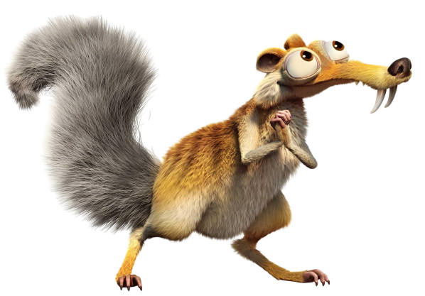
BE RESPECTFUL
R-E-S-P-E-C-T
Be kind.
Be considerate.

Slide 10
Assignment #1
If you could add something else to this list, what would
you add?

Slide 11
Assignments Overview
You will be creating an online or paper document for daily assignments this week. You will turn this document in to your teachers by Monday, August 17 through Google Classroom.

